Slide 1

Gaussian Process Emulation for Mathematical
Models of the Heart
Hongjin Ren
Supervisors: Dr Benn Macdonald, Dr Vinny Davies, Dr Mu Niu, Dr Hao Gao

Slide 2
Outline
Introduction
Biomechanical model of left ventricular dynamics
Methodology
Emulators
Results
Future Work

Slide 3
Introduction
Background:
Cardiovascular disease is a major global public health problem and mathematical model of cardiac function can give some supports for early diagnosis and treatment strategies.
Combined with cardiac MRI data, left ventricular (LV) model can be used to predict and assess cardiac systolic dysfunction, which is a common cause of heart failure.
The construction of the LV model is based on the Holzapfel-Ogden constitutive law, and solving the model relies on the finite element method, which is a complex and time-consuming process.
The numerical integration of mathematical models can be avoided by using emulator, which also can improve real-time analysis for clinical applications.
Project objective:
Design and optimisation of emulators in complex input and output spaces, using these emulators to improve the efficiency and accuracy of parameter inference.
Notes:
Heart disease is one of the world's major health problems. Many mathematical models have been developed to relieve this problem. In recent years, we have already kwon that combined with MRI data LV models can help with the early diagnosis of heart failure. This model is described by some nonlinear functions, and we didn’t have a fixed solution for these equations.

Slide 4
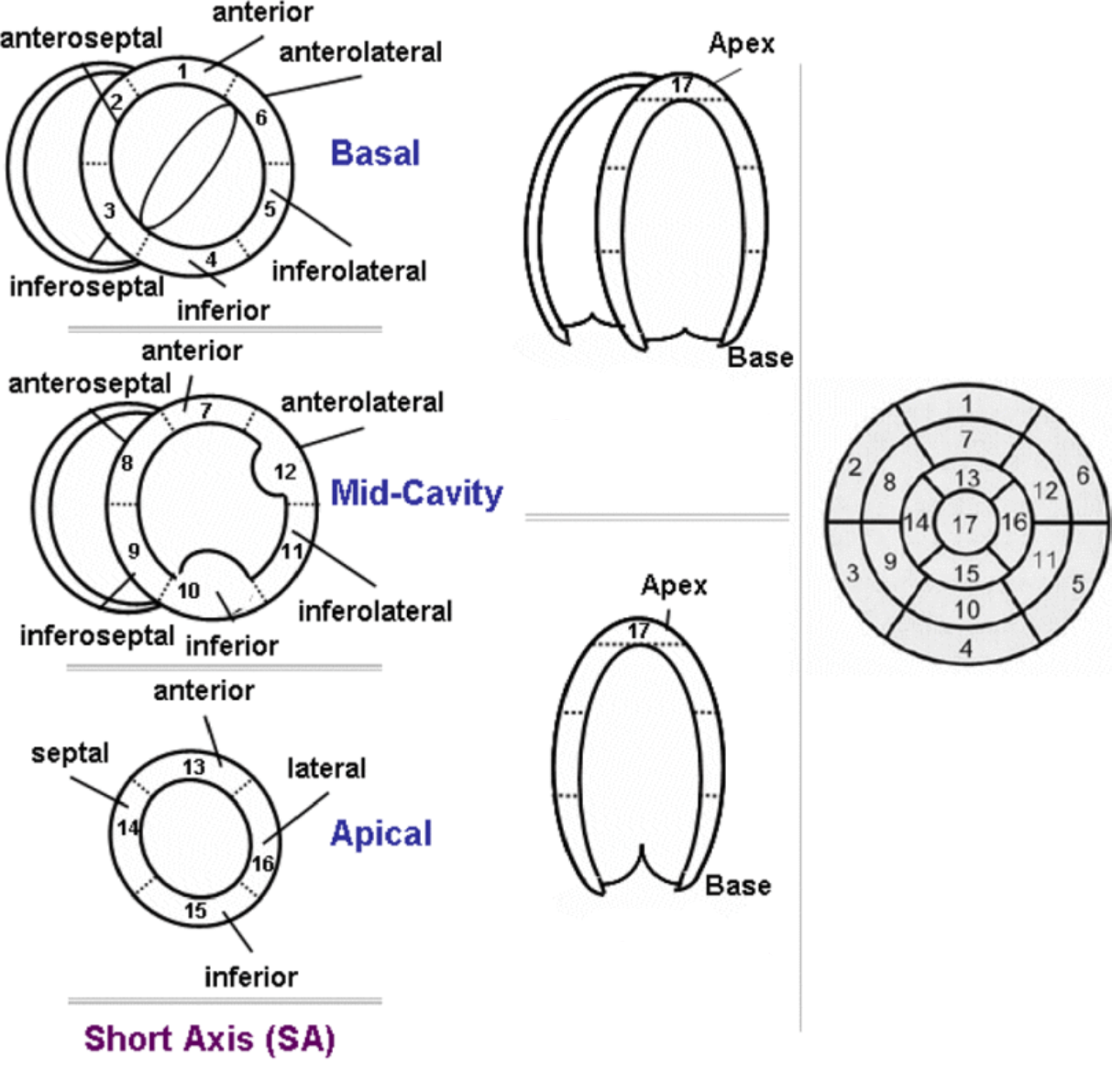
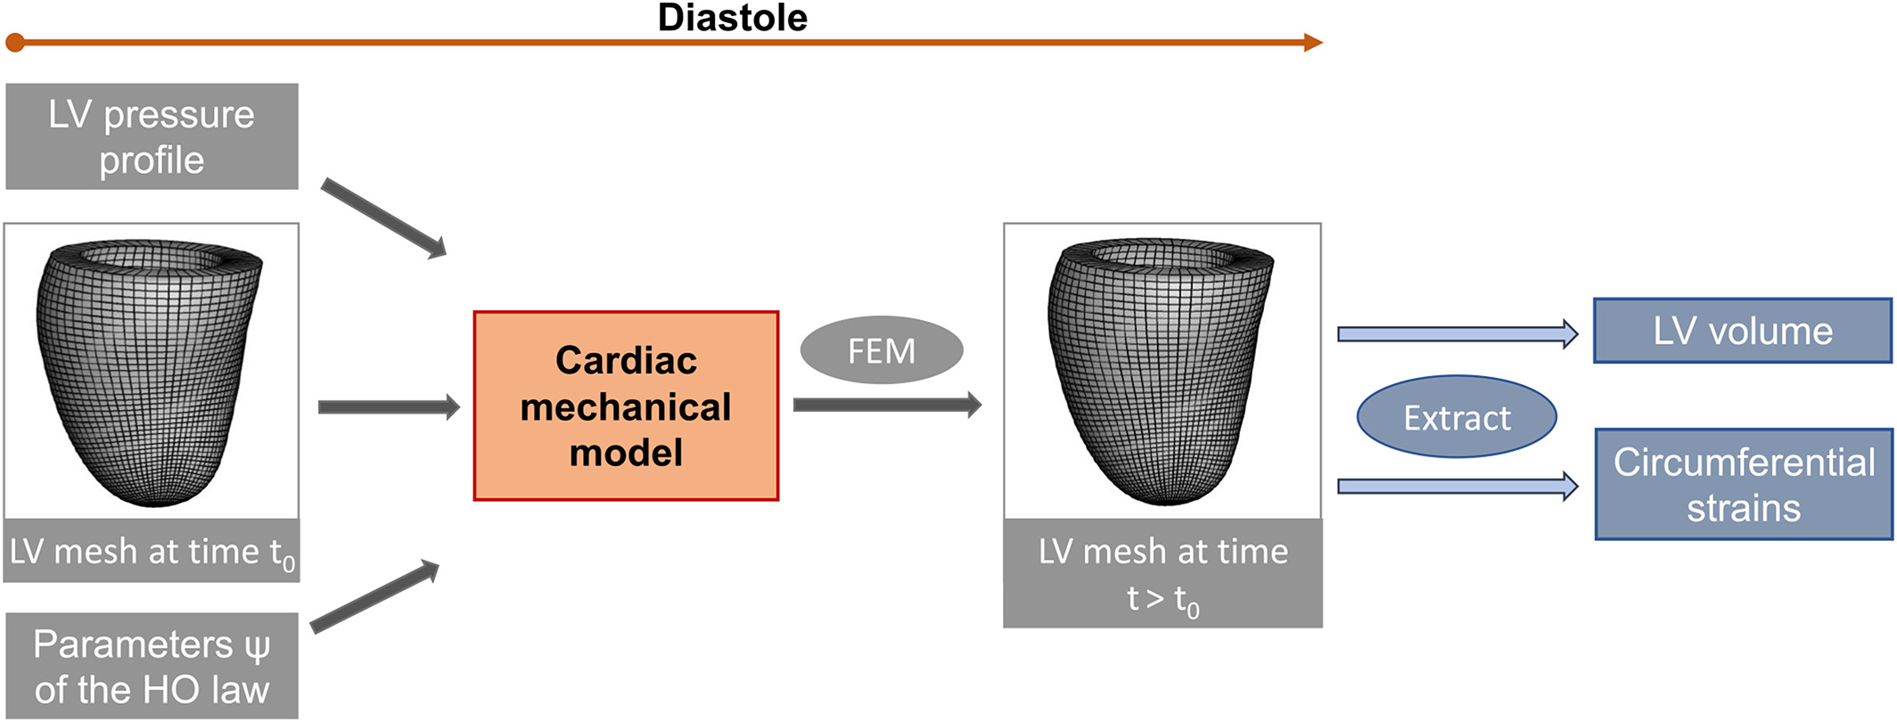
Biomechanical model of left ventricular dynamics
The left ventricle (LV) model describes the diastolic filling process of the heart.
Left ventricular geometry

Slide 5
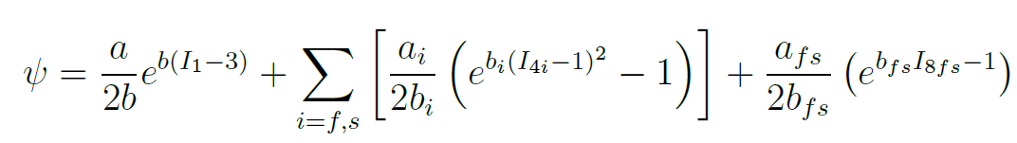
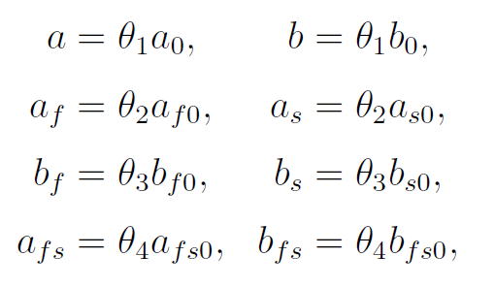
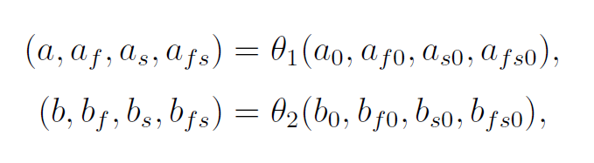
Biomechanical model of left ventricular dynamics
The Holzapfel–Ogden(H–O) constitutive law is the main part of the left LV model.
Holzapfel–Ogden(H–O) constitutive law
Bio-mechanical Parameters
Ⅰ.
Ⅱ.

Slide 6
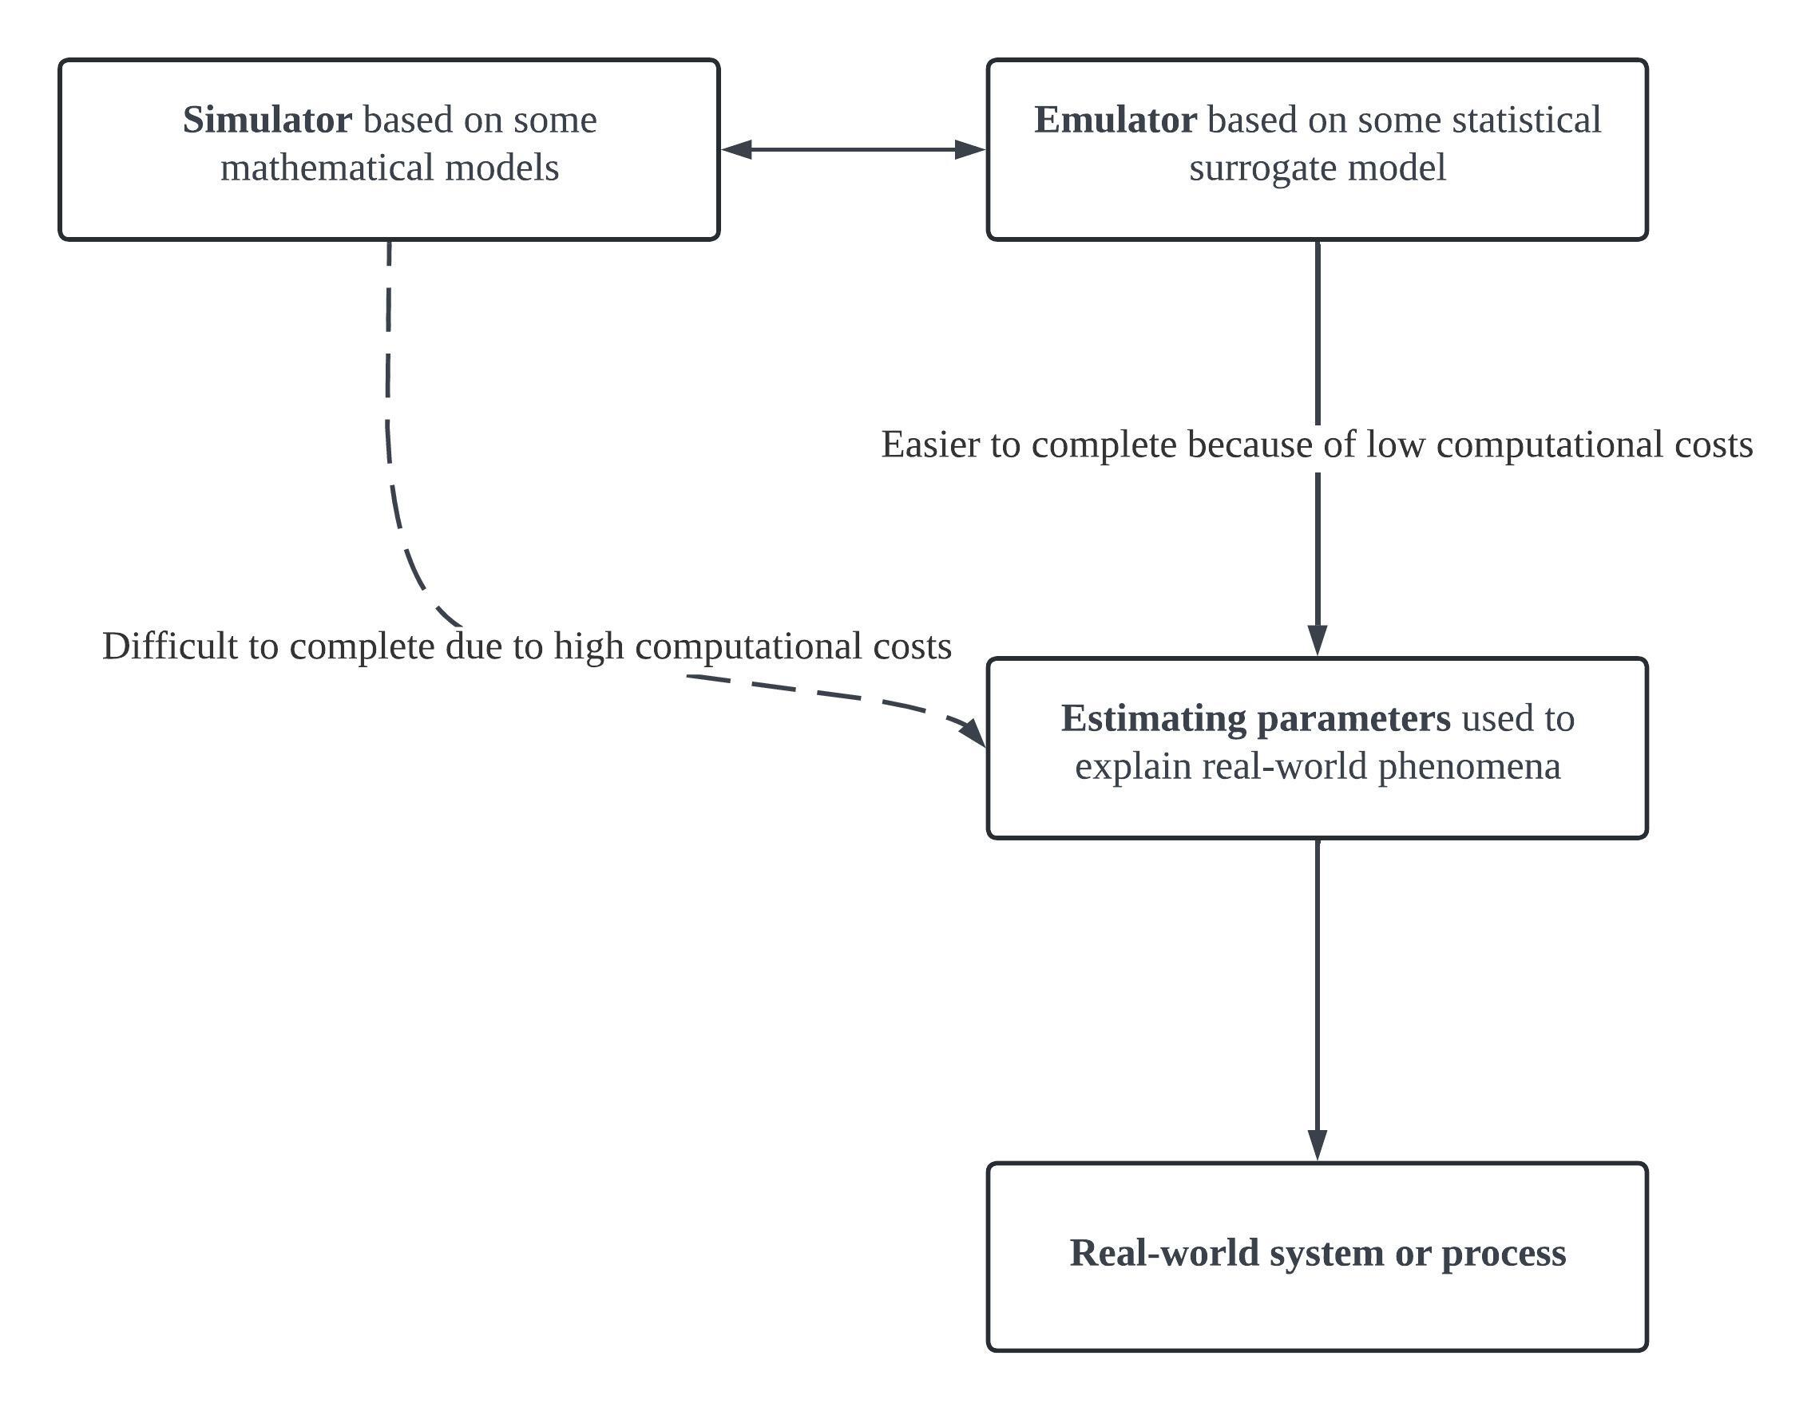
Methodology
Simulator is solved numerically by finite element discretisation, which typically takes about 20 minutes per solution.
Emulator is an approach that circumvents the highly computational task of direct numerical simulation. This approach significantly reduces the computational effort compared to direct simulation.
Parameter estimation is performed using a trained emulator. The goal is to find optimal parameters that minimise the loss between the emulator predictions and the actual patient observation data.

Slide 7

Emulators
Gaussian Processes
Gaussian process (GP) regression is a powerful nonparametric Bayesian regression technique.
GP is fully represented by its mean and covariance functions.
Emulators
Local Models
Global Models
Standard GP with single-output
Standard GP with multi-output
GP with Deep Kernel Learning
Variational GP
Deep GP
Neural Network

Slide 8
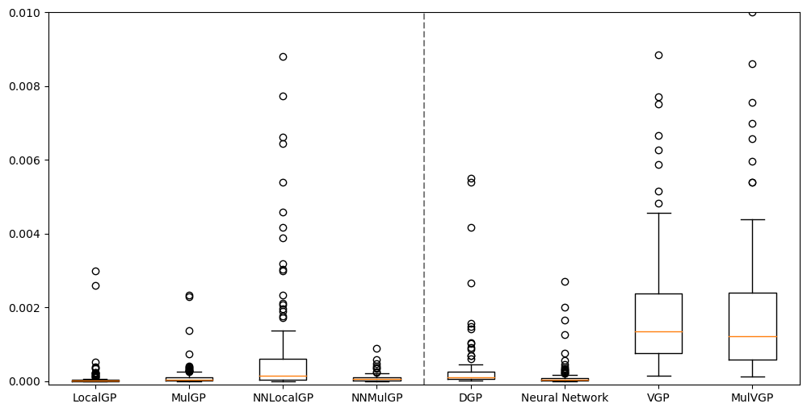
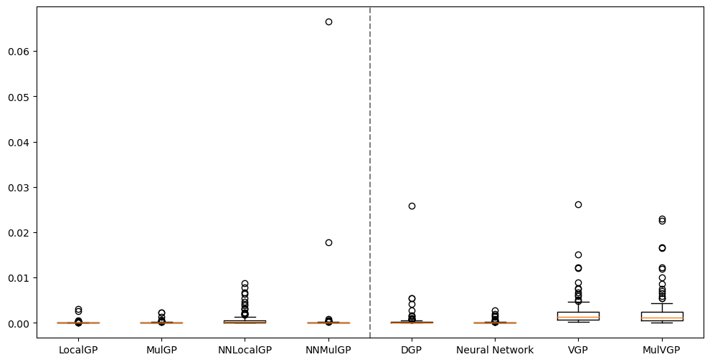
Results
(Zoom boundary)
The emulators were trained using the training set and compared the MSE of them in the test set.
MSE
Local Models
Global Models

Slide 9
Future work
Toy Problem Exploration:
Priority was given to completing the toy problem mentioned in the current study. The problem is intended to guide the experimental design process leading to more detailed and efficient simulation data and simulators.
Refinement of Emulation Techniques:
Building on the foundations established in the first year, ongoing work will continue to refine GP emulation methods and apply them to the task of high-dimensional parameter estimation for LV model.
Publications:
Publish results in an appropriate conference or journal, integrating all work done to date.

Slide 10
Thanks for listening!

